Slide 1
CREDIT CARD CHURN PREDICTOR
Diana Madonko
Franz Kiel
Jason Sutton
Swobabika Jena
Thomas Maina
Will Bobzin

Slide 2
The day you sign a client is the day you start losing them.
-Don Draper – Mad Men

Slide 3
Roadmap
Topic selection & dataset acquisition
Machine learning model development
Front-end to back-end connection.
1
3
5
2
4
6
Exploratory analysis & Data Wrangling
Front-end development
Product deployment and testing

Slide 4
Topic Selection & Dataset Acquisition
1
Challenges and opportunities with datasets

Slide 5
Why bank churning prediction?
Real
We wanted to develop models with actual business applications.
Applicable
If applied to the right data, the models can work with many different industries besides banks. From health insurance to fitness centres and streaming services.
Reliable
Bank data is expected to be of high quality, particularly for demographic information. Document proof is usually required.

Slide 6
Expected Final Product
A tool that can predict likelihood of a customer leaving the bank:
HTML front end to capture client data
Machine learning model operating in the background
Reliable prediction for any given customer
This tool could be applied in different fields if applied to relevant datasets.

Slide 7
Exploration & Wrangling
2
Diving into the Data

Slide 8
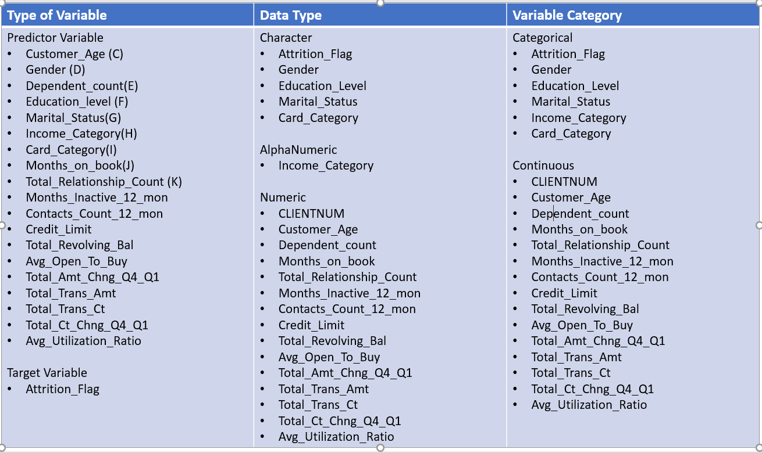
Exploration Outcomes– Variable Identification
Identified type of data and category of each variable
Serves as reference at exploration and execution stages

Slide 9
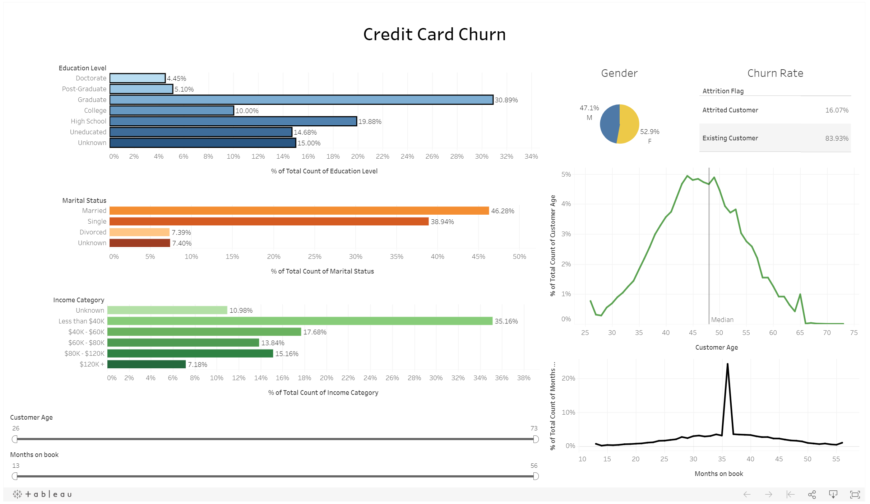
Exploration Outcomes– Univariate Analysis
Notes:
Education level data is not solid, 15% stated “Unknown”
Similar issue with Marital Status, with 7.4% “Unknown”.
Clear bias detected in Length of Relationship – 24.3% of customers have been so for exactly 36 months.

Slide 10
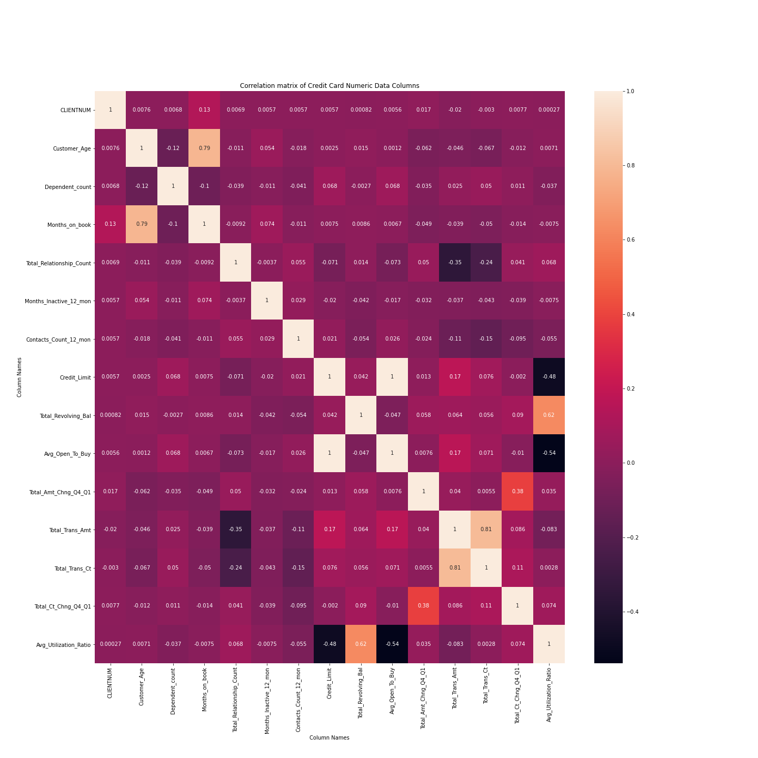
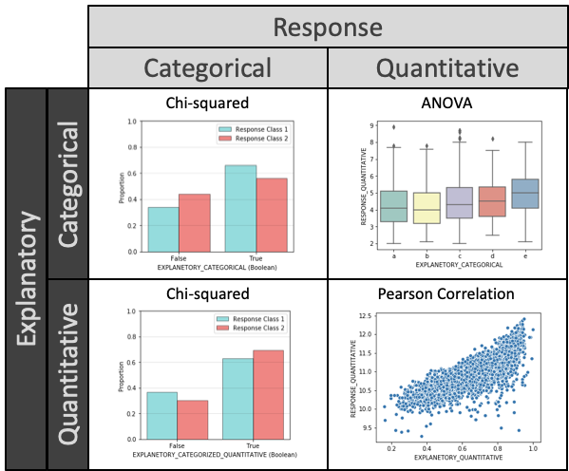
Exploration Outcomes– Multivariate Analysis
Notes:
Correlation Matrix
Applied to all continuous variables
Displays degree of correlation between variables
Analysis of explanatory and response variables

Slide 11
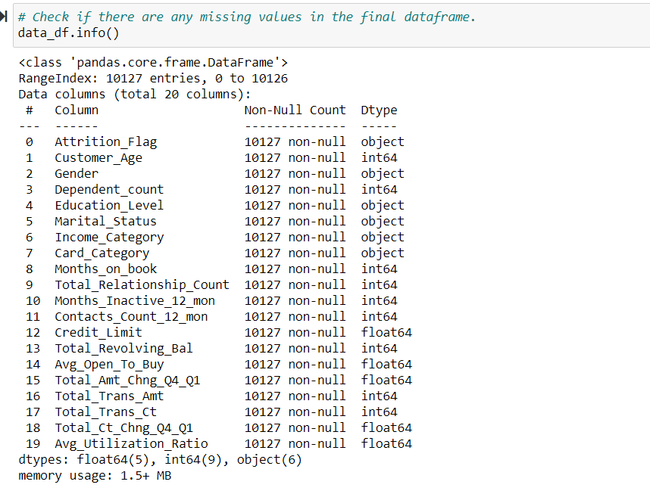
Exploration Outcomes– Missing Value Treatment
No missing values in the dataset

Slide 12
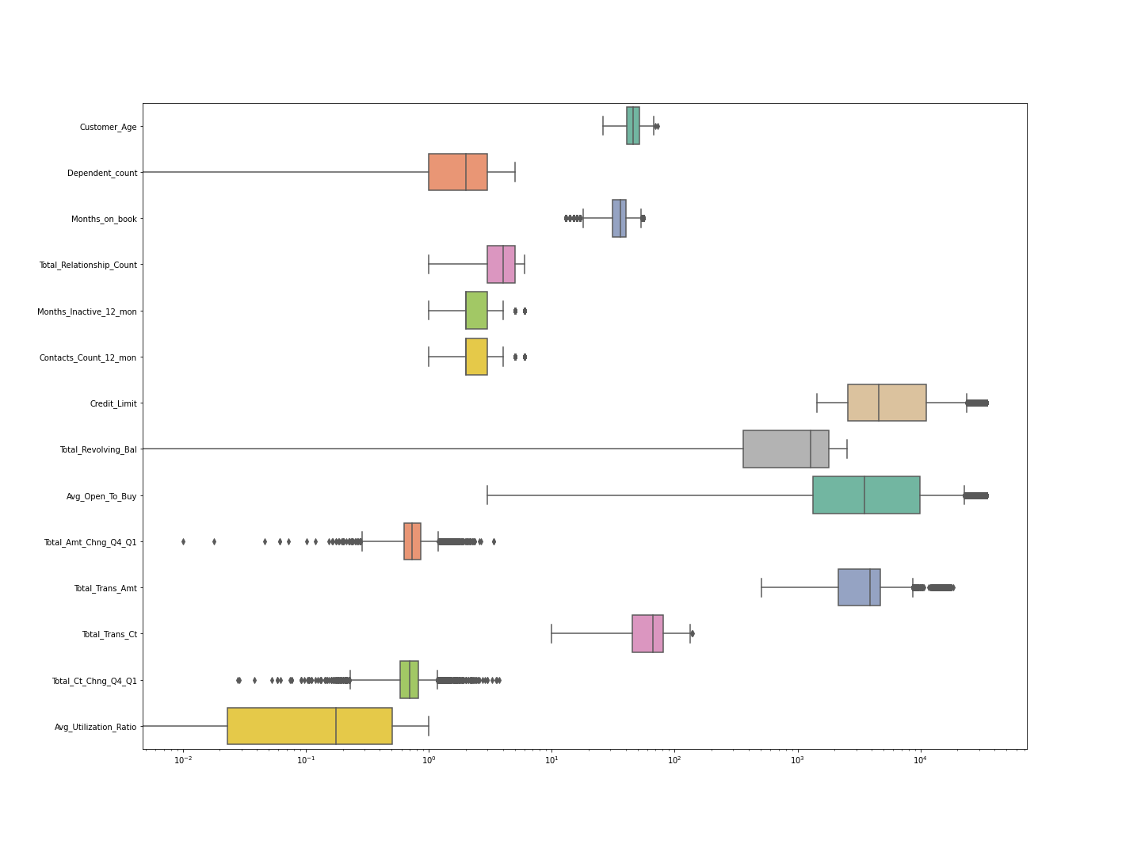
Exploration Outcomes– Outlier Treatment
Many variables show outliers
These outliers seem naturally occurring

Slide 13
Exploration Outcomes– Conclusions
‘Credit_Limit’ and ‘Avg_Open_To_buy’ columns have a perfect positive linear correlation of almost 1, hence we decided to retain ‘Avg_Open_To_buy’ column only
2. ‘Total_Trans_amt’ and ‘Total_Trans_ct’ have a strong positive linear correlation of 0.81 . The way we dealt with it was to perform ‘Total_Trans_amt’/‘Total_Trans_ct’ to get a new column 'Amt_per_Trans'.

Slide 14
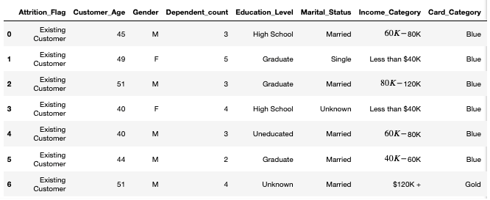
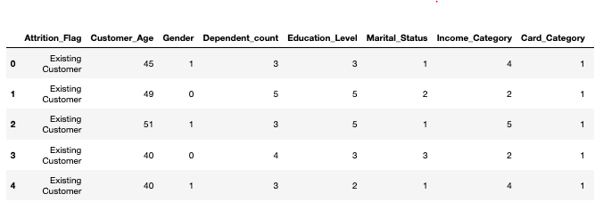
Exploration Outcomes– Pre-processing
Ordinal and non-ordinal categorical features
Split data into X (features) and Y (classes)
Split data into Train and Test data
Label Encoding Y classes One-hot encoding
Before After

Slide 15
Machine Learning Model Development
3
Applying and comparing models

Slide 16
Machine Learning Model Development - Modelling Approach
Models
Decision Tree – Score 0.937
Random Forest – Score 0.962
Logistic Regression – Score 0.88
K Nearest Neighbour – Score 0.9
Notes:
Trialling 4 model, you can see that there was three vying for top place, but the winner is the Random Forest.
This result was achieved without a Grid Search – I found that running a Grid Search could take quite a bit of time for the computer to process. If time was permitting, it would have interesting to see if it would have resulted in a better score.
We were pretty happy with 96% accuracy.

Slide 17
Modelling Approach - Conclusion
RANDOM FOREST:
92.18% Actual Accuracy
28 customers incorrectly predicted out of 358
This model allows us to confidently make predictions.
Notes:
I did a comparison data frame the success slightly dipped but still happy with this accuracy

Slide 18
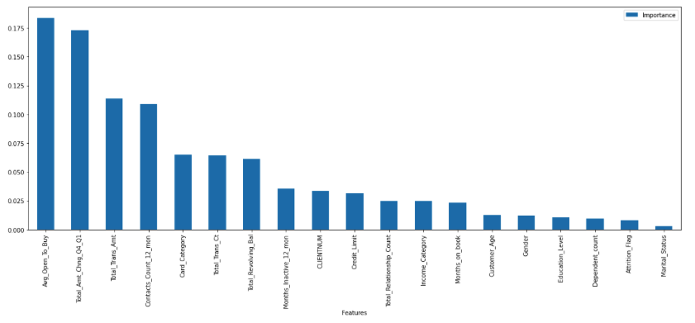
Modelling Approach – Feature Importance
Further exploration could occur to determine if some features were unnecessary
Open_To_Buy
Total_Amt_Chng_Q4_Q1
Trans_Amt
Contacts_Count_12_mon
Card_Category
Total_Trans_Ct’),
Total_Revolving_Bal'
Notes:
Generating the feature importance
Open_To_Buy
Total_Amt_Chng_Q4_Q1
Trans_Amt
Contacts_Count_12_mon
Card_Category
Total_Trans_Ct’),
Total_Revolving_Bal'

Slide 19
Front-End Development
4
Making models accesible to users

Slide 20
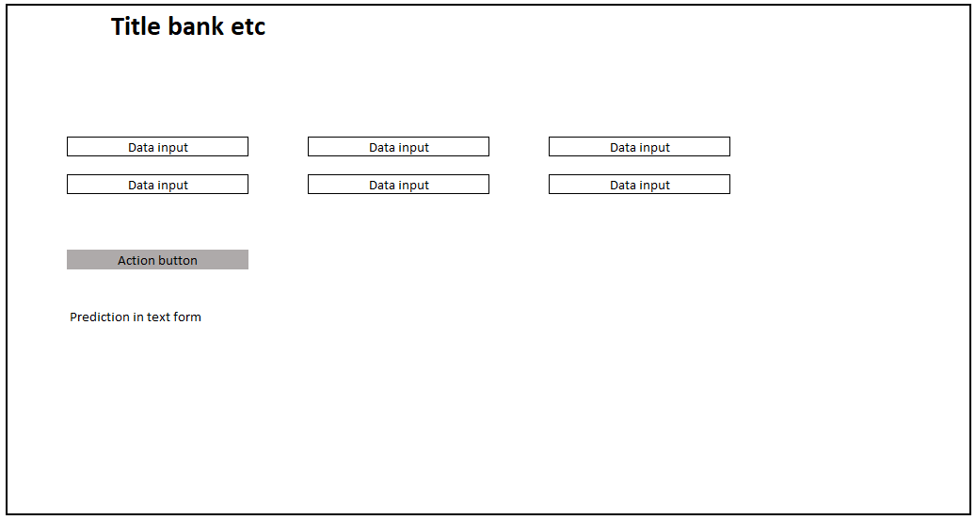
Front-End Development – Early Draft

Slide 21
Front-End Development - Tools
Tools
HTML – Web Interface
CSS - Styling
JavaScript & D3 – user input collection and back- end parsing
CSV file support for mass modelling

Slide 22
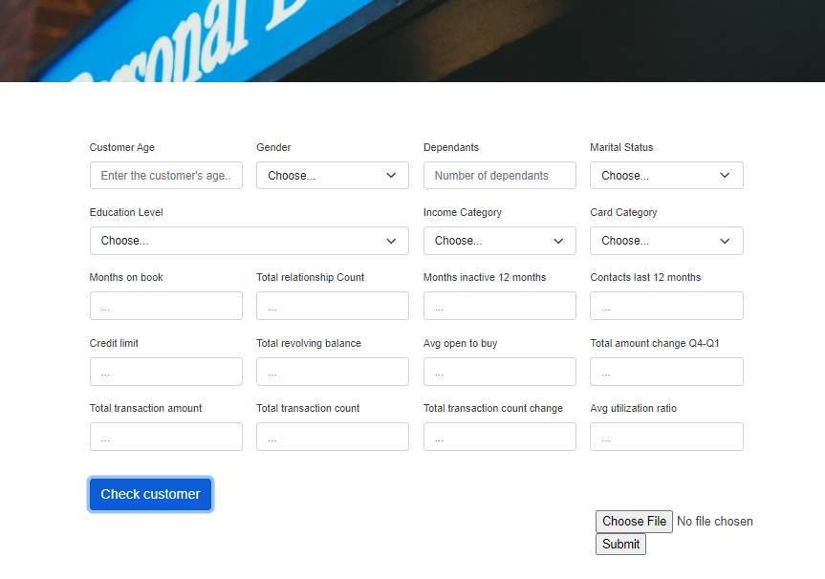
Front-End Development – User Interface
Drop downs for ease of use (categorical data)
File upload support (CSV)
Button to trigger check
Simple, clean visual identity

Slide 23
Front-End to Back-End Connection
5
Bringing the pieces together

Slide 24
Front-End to Back-End Connection- Tools
Tools
Flask – two routes
User individual selection
@app.route(“/individual”,methods=[“POST”] def individual():
CSV file
@app.route(“/bulk”, methods=[“POST”]) def bulk():(
Pre-processing
Machine Learning – imported model
Return results to JavaScript to visualise on screen

Slide 25
Product deployment and testing
6
Making the final product accesible

Slide 26
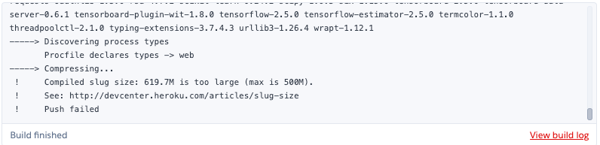
Product deployment and testing- Heroku
Challenges
Slug ignore file
File size limits

Slide 27
Ideas and Improvements
Things that could have been done differently:
Implemented a database
Streamlined interface – less input fields
Delve deeper into dataset
This model allows us to confidently make predictions.

Slide 28
CONCLUSION
Our tool achieves the objectives, by collecting information for a given customer or customers and predicting whether they are at risk of cancelling their credit card.

Slide 29
Exploration Outcomes– Basic Information
23 columns
Mostly demographic information
Bank-related data – type of credit card, transactions made, etc.
10127 Rows
No Null values
‘CLIENTNUM’ as Index
Many “Unknown” values

Slide 30
Front-End Development – additional content?
Here you have:
Anything else we want to mention?
And some text

Slide 31
Front-End to Back-End Connection– additional content?
Here you have:
Anything else we want to mention?
And some text or screenshot?

Slide 32
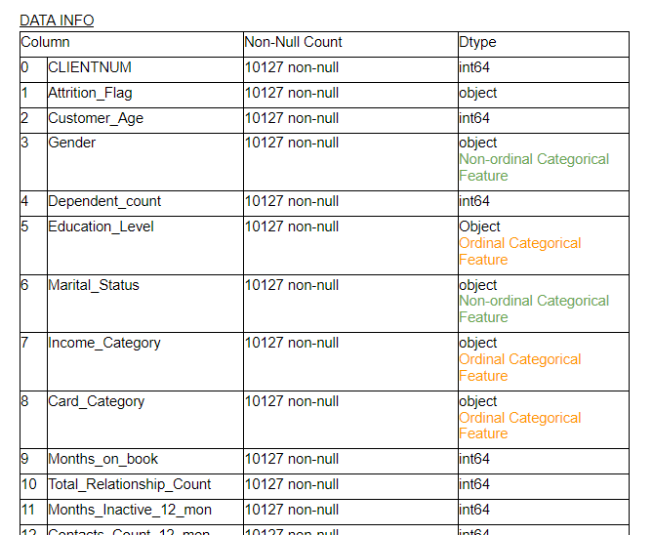
Exploration Outcomes– Univariate Analysis
Basic table with type of data for each column
Serves as reference at exploration and execution stages

Slide 33
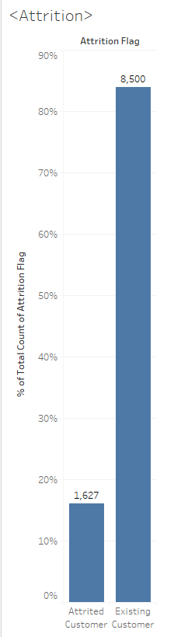
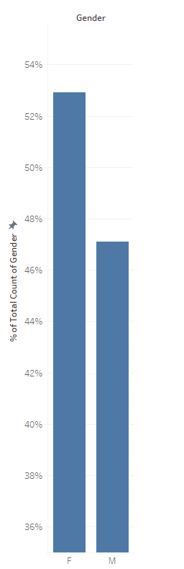
Exploration Outcomes– Univariate Analysis
16% of customers in the data set have closed their accounts.
Gender is slightly biased towards Males, but not significantly.

Slide 34
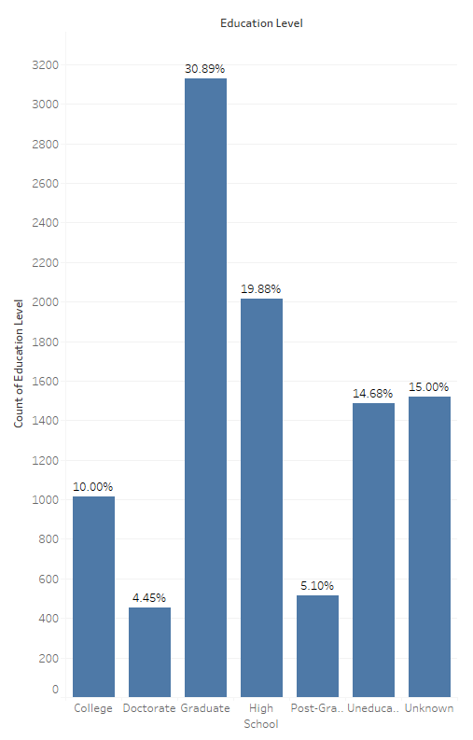
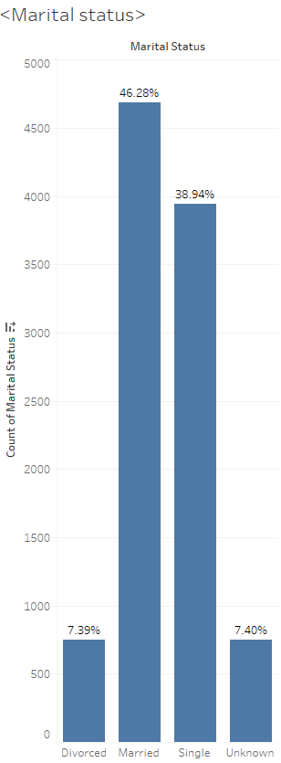
Exploration Outcomes– Univariate Analysis
Education level data is not solid, 15% stated “Unknown”
Similar issue with Marital Status, with 7.4% “Unknown”.
Notes:
Education level data is not solid, 15% stated “Unknown”
Similar issue with Marital Status, with 7.4% “Unknown”.

Slide 35
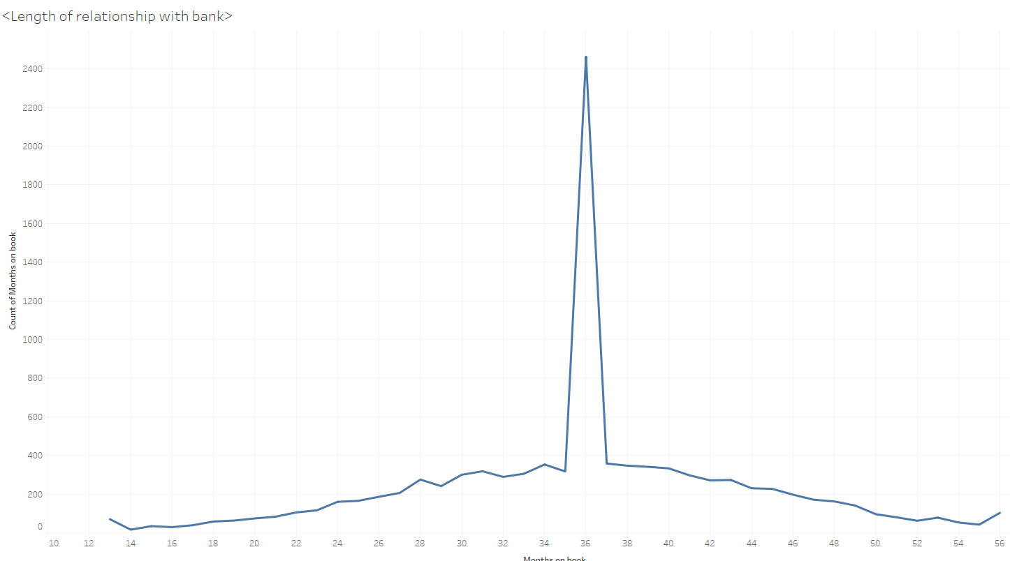
Exploration Outcomes – Univariate Analysis
Clear bias detected in Length of Relationship – 24.3% of customers have been so for exactly 36 months.

Slide 36
Exploration Outcomes– Multivariate Analysis
Statistical tests
Analysis of explanatory and response variables

Slide 37
Exploration Outcomes– Multivariate Analysis
Correlation Matrix
Applied to all continuous variables
Displays degree of correlation between variables

Slide 38
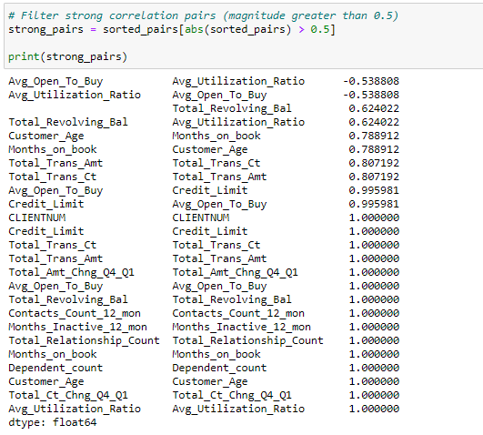
Exploration Outcomes– Multivariate Analysis
Through Pandas, sort pairs of columns based on correlation strength.
Some variables are predictably correlated (eg. “Credit Limit” and “Avg Open to Buy”)

Slide 39
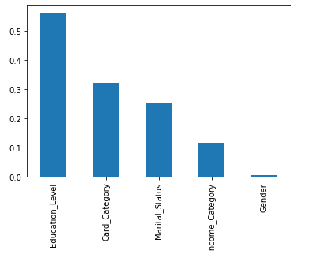
Exploration Outcomes– Multivariate Analysis
Chi-Square Tests
Five category predictors and one category response “Attrition_Flag”
All parameters show p-value>0.05. Variables are independent of the response parameter and can’t be considered for model training.

Slide 40
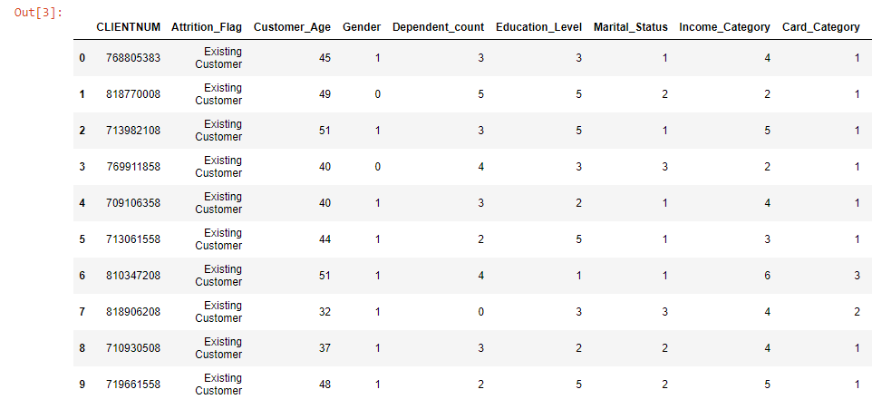
Final Dataset
21 Columns
Fully encoded – using integers to represent categorical features (eg. ranking by income bracket)

Slide 41
Modelling Approach– Random Forest
Powerful classification model
92.48% Actual Accuracy
27 customers incorrectly predicted out of 359
Most representative code or chart snapshot?

Slide 42
Modelling Approach– Logistic Regression
Resource efficient classification model
88.7% Test model Accuracy
90.16% Training Model accuracy
Comments?
Most representative code or chart snapshot?

Slide 43
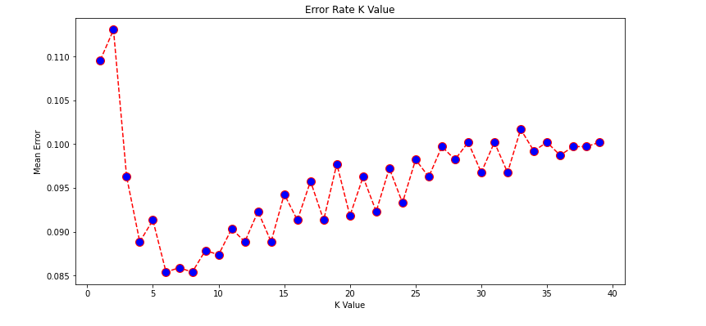
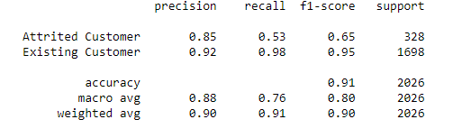
Modelling Approach– K Nearest Neighbour
Straightforward classification algorithm
0.91 F1 Score
How to express the accuracy?
Most representative code or chart snapshot?

